Slide 1

2016 and 2020 Summer Olympic Data
Blake davis – DSCI 235

Slide 2
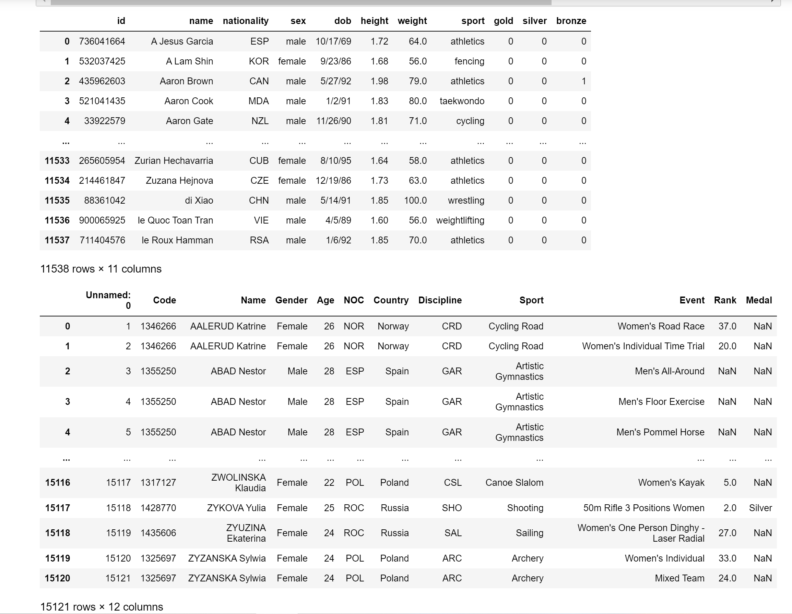
My Datasets

Slide 3
The Questions I Wanted to Answer
1. What is the average age of an Olympic athlete in 2016? 2020? Compare.
- Which events have a mean age greater than 30? Which events have a mean age greater than 28?
2. Who are the 5 oldest athletes and who are the 5 youngest athletes in 2016 and 2020?
- What country are they from?
- What sport do they compete in?
- What does the age distribution of their sport in 2016 and 2020 look like, if available?
- Do any of them compete in the events that tend to have younger or older competitors, respectively?
3. Which Olympic athlete has the most medals in 2016?
4. What are the top medaling countries in 2016? 2020? Compare.
5. Does the United States have more female or male medalists in 2020?
- What is the average age of United States Male Medalists? Of United States Female Medalists? Of All United States Medalists?

Slide 4
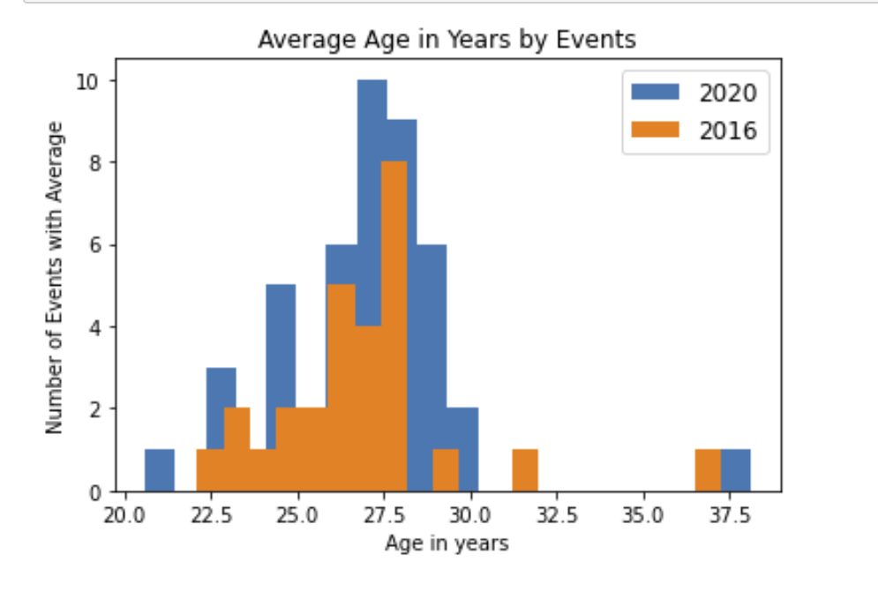
Mean Age

Slide 5
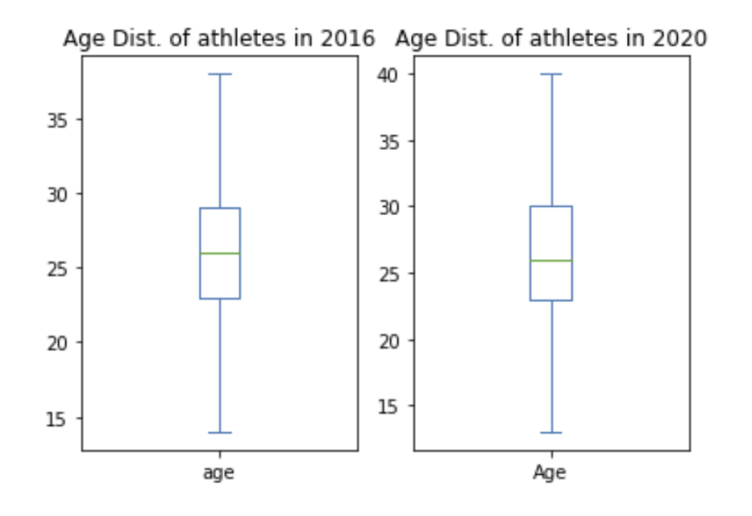
Age Distribution

Slide 6
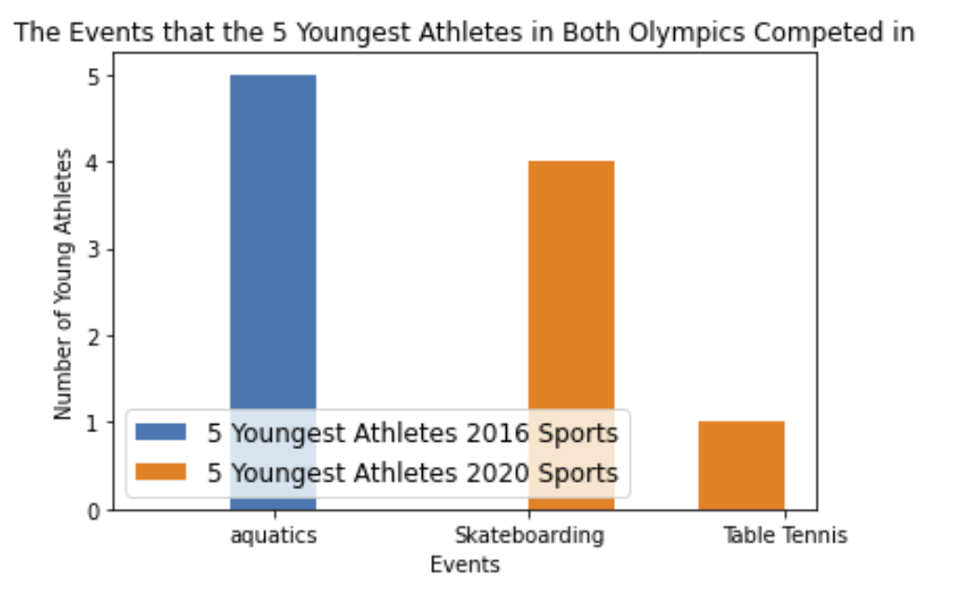
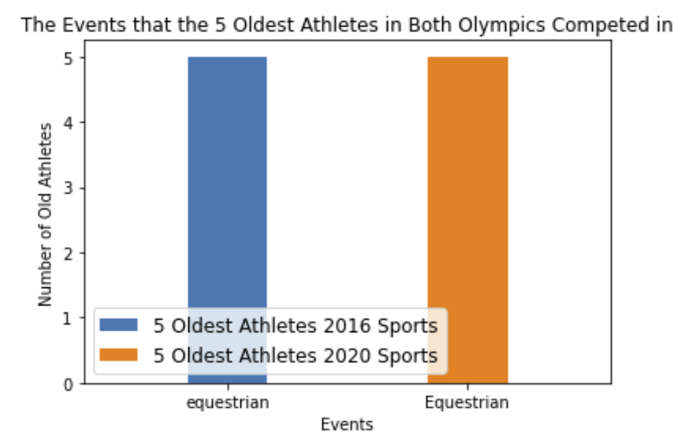
Young and Old Competitors

Slide 7
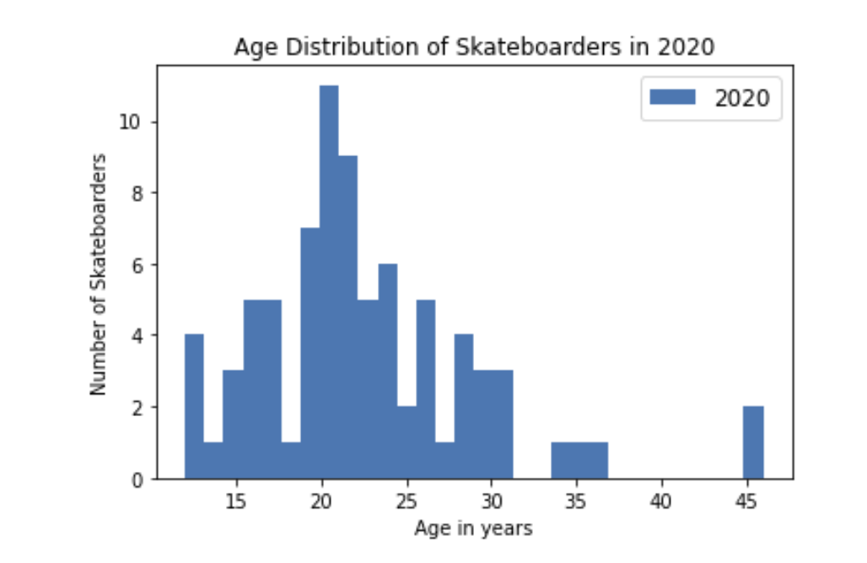
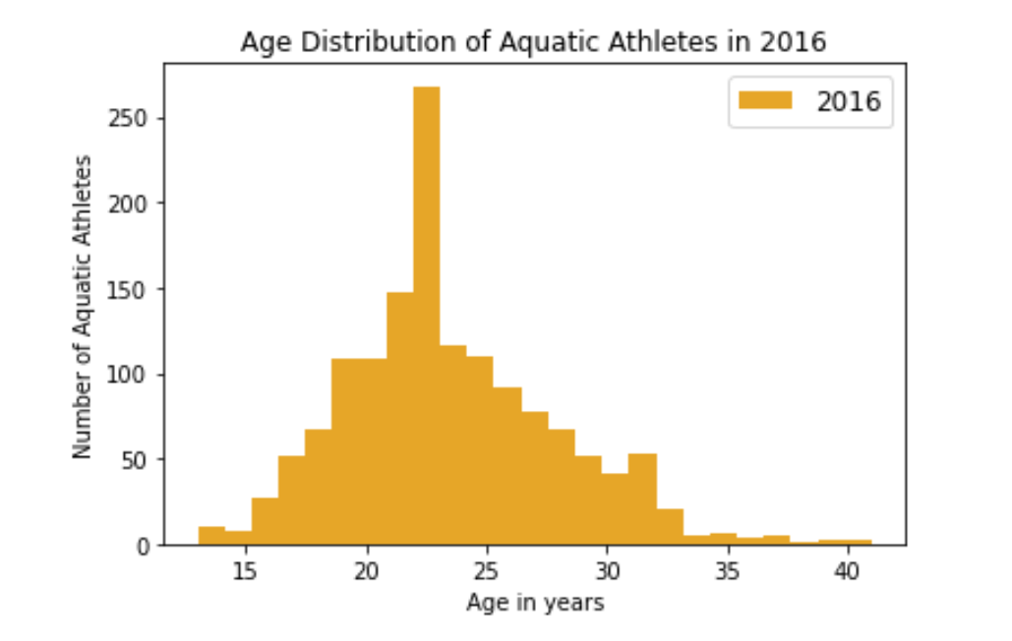
Aquatic Athletes and Skateboarders

Slide 8
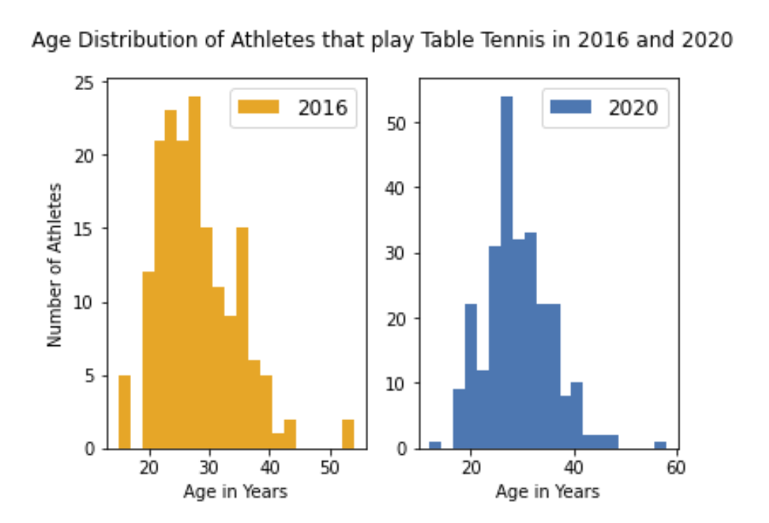
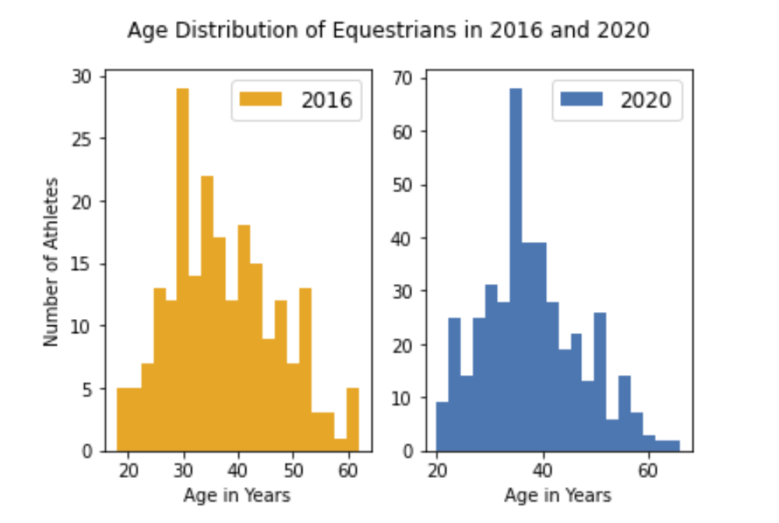
Athletes that play Table Tennis and Equestrians

Slide 9
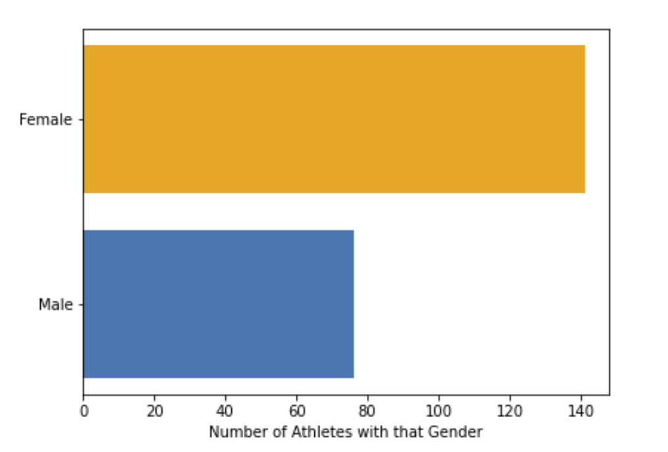
Does the US have more female or male medalists in 2020?

